Slide 1
Context
Date Line
Search
Date Start:
Date Stop:
Keywords:
Results
Items:
Item Keywords:
Info Box:

Slide 2
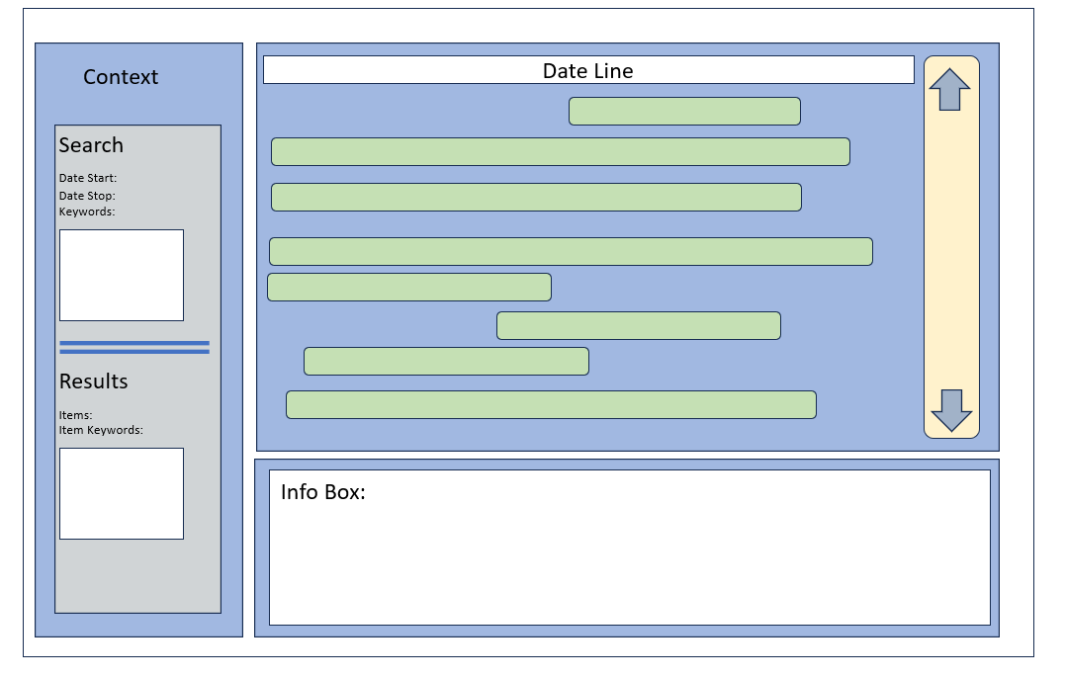

Slide 3
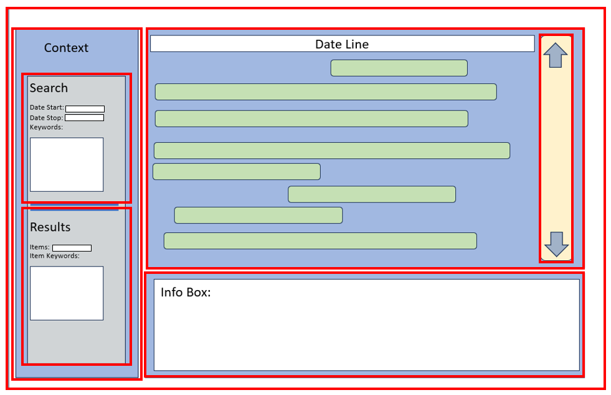
Frames
MainFrame
SideFrame
TitleLabel
SearchFrame
SearchLabel
DateStartLabel
DateStartEntry
DateStopLabel
DateStopEntry
SearchKeywordsLabel
SearchKeywordsEntry
ResultsFrame
ResultsLabel
ItemsLabel
ItemKeywordsLabel
ItemKeywordsEntry
ViewFrame
ScrollFrame
InfoFrame

